Slide 1
Charles Frank Cycle 1
Project: Determine Student Activity on Linux Server
Idea: Dr. Halverson, DSU Computer Science Professor

Slide 2
Dr. Halverson
Email Communication with Dr. Halverson:
“My goal is to be able to determine which students have logged in, who has been working since the last assignment was assigned, when was the last time a user did anything, etc. Basically a tool to determine how my students are doing.”

Slide 3
Some Important Info:
Github Repository:
infosecchazzy/CSC842-Security-Tool-Development/cycle1/
Script Name:
last_logon.py
POWERPOINT Presentation Filename:
Charles Frank Cycle 1 Presentation

Slide 4
LINUX OS LOGIN LOGGING
/var/log/wtmp file
Non-ASCII, Binary File
Example of last command from Dr. Halverson:
% last p5*
p501 pts/11 138.247.149.21 Thu Mar 24 19:42 still logged in
p501 pts/14 138.247.149.21 Thu Mar 24 09:37 - 09:41 (00:04)
p501 pts/20 138.247.99.195 Thu Mar 24 07:07 - 08:08 (01:01)

Slide 5
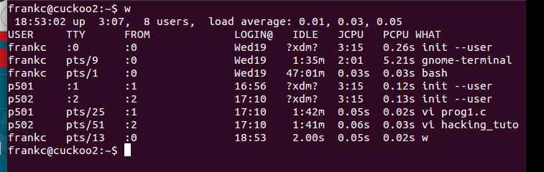
LINUX ACTIVITY MONITORING
The w command displays who is logged into and what commands are being executed.

Slide 6
Command Line Options:
USAGE:
usage: last_logon.py [-h] [-p <PATTERN>] [-s <STARTING>] [-e <ENDING>] [-l]
[-n] [-t] [-m]
DSU Linux User Last Logon Script
optional arguments:
-h, --help show this help message and exit
-p <PATTERN> PATTERN for class
-s <STARTING> STARTING from student number
-e <ENDING> ENDING with student number
-l Last Logon of students
-n Total Number of Logons
-t Total Amount of Logon Time per student
-m Monitor student activity

Slide 7
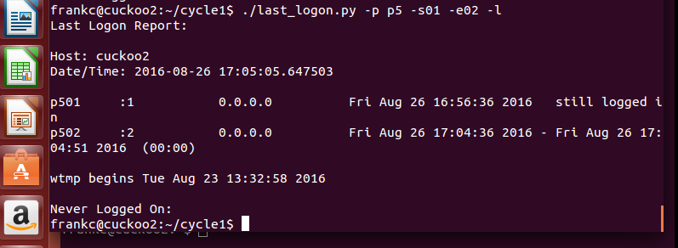
Simple Example

Slide 8
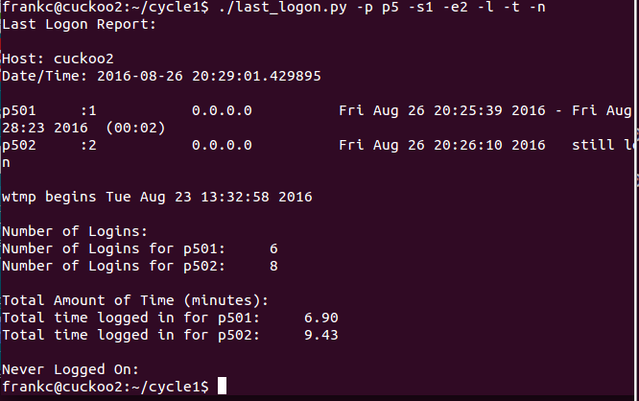
Another example:

Slide 9
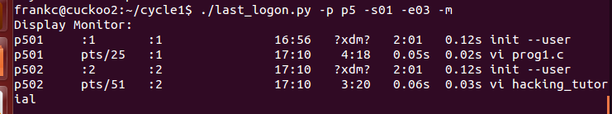
Final Example:

Slide 10
In Main:
parser.add_argument("-p",
dest="student_pattern",
default="*",
help="PATTERN for class",
metavar="<PATTERN>")
parser.add_argument("-s",
dest="student_starting",
default=1,
type=int,
help="STARTING from student number",
metavar="<STARTING>")

Slide 11
More Python:
student_list = get_student_list(args.student_pattern,args.student_starting, args.student_ending)
display_last_logon(student_list,args.l,args.n,args.t)
display_monitor(student_list)

Slide 12
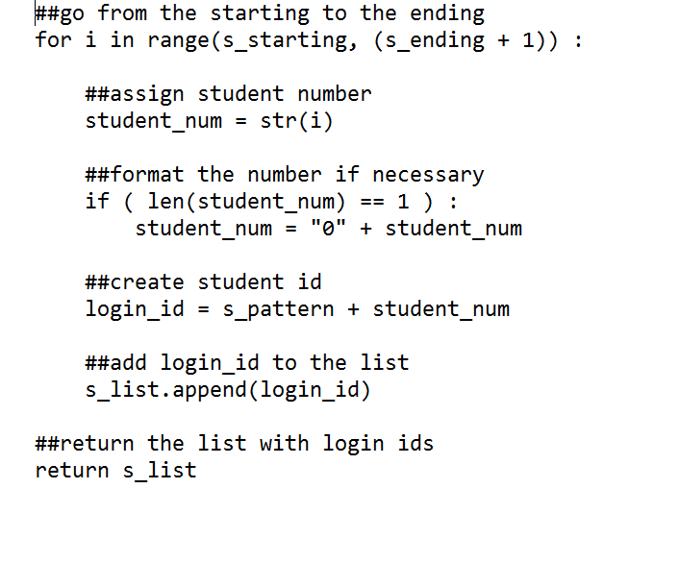
Get Student List

Slide 13
DISPLAY LAST LOGON
##construct last command and grep for the student id
linux_cmd = "last -Fd " + linux_id
##open a process with the linux command
p = subprocess.Popen(linux_cmd, stdout=subprocess.PIPE, shell=True)
##assign the output for the command
(output, err) = p.communicate()
##wait for the command to complete
p_status = p.wait()
##split the output into individual lines
each_output_line = output.splitlines()

Slide 14
DISPLAY LAST LOGON
##go thru each line of output from the last command for the linux_id
for a_line in each_output_line:
##there is an entry for the linux id
##report on the latest entry from the last command if flag_l set
if first_line :
if flag_l :
print(a_line)
first_line = False

Slide 15
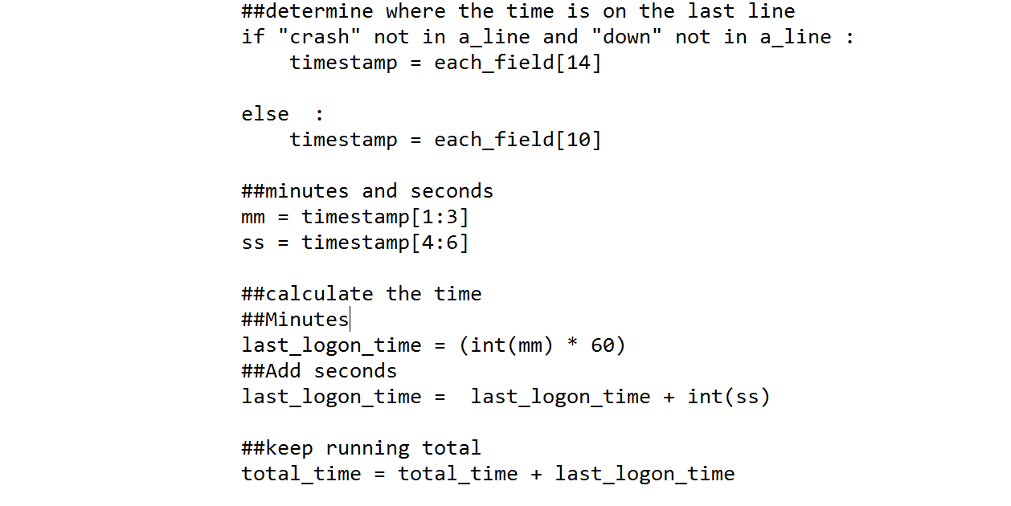
DISPLAY LAST LOGON

Slide 16
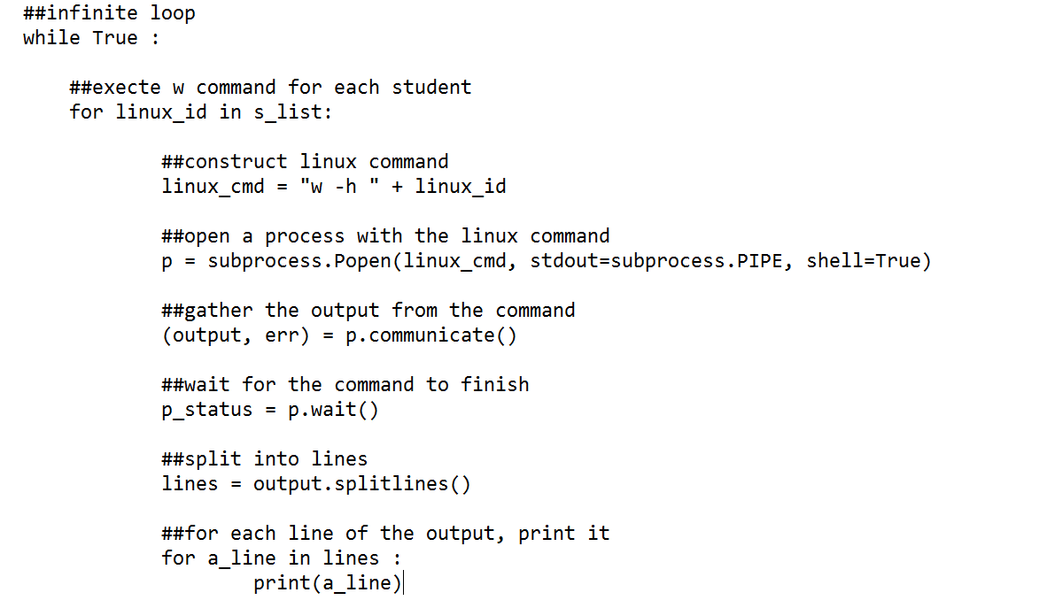
DISPLAY MONITOR

